Slide 1
http://team-burnt-orange.com
https://github.com/BURNT-ORANGE/Web-Fundamentals-Teamwork

Slide 2

Brain battle
Web fundamentals Teamwork, team burnt orange
SoftUni, October 2014

Slide 3
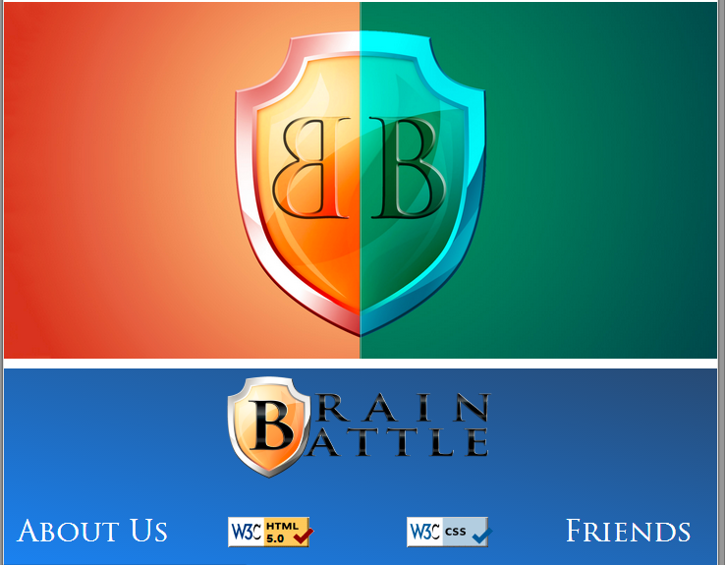
Project name and purpose
Name – “Brain Battle”

Slide 4
Burnt orange MEMBERS
Velizar Bishurov (vbishurov) – html + css
Boyan Baychev (mb_int) – idea and plan
Hristo Hristov (hristo9153) – php includes
Angel Kabadiev (furious_angel) – photoshop logos

Slide 5

Tools and resources
GitHub
https://github.com/BURNT-ORANGE/Web-Fundamentals-Teamwork
HTML 5, CSS 3, PHP, Kickstart(at start) – Bootstrap(finished)
Superhosting
Facebook, Skype

